Slide 1

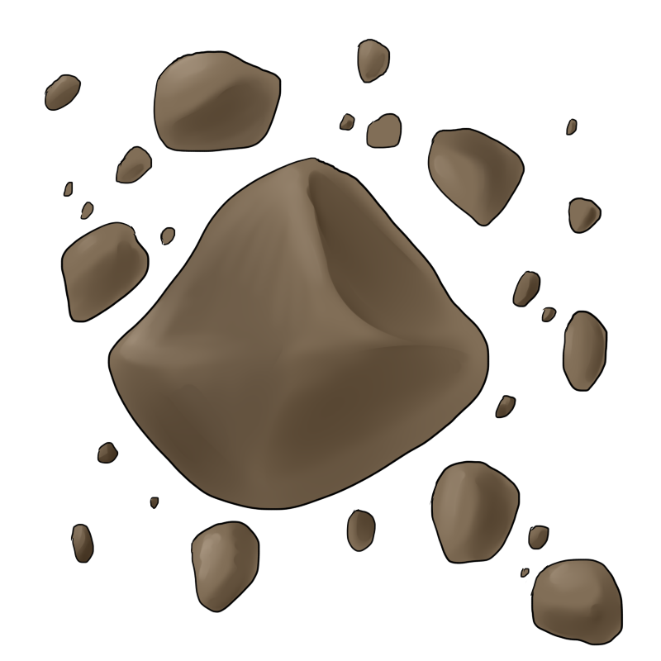
Research – Week 3
George Hutchings

Slide 2
Tasks
As a designer research and design some asteroids to use for our game.
As a designer research the different potential space backgrounds we can use for our game.

Slide 3
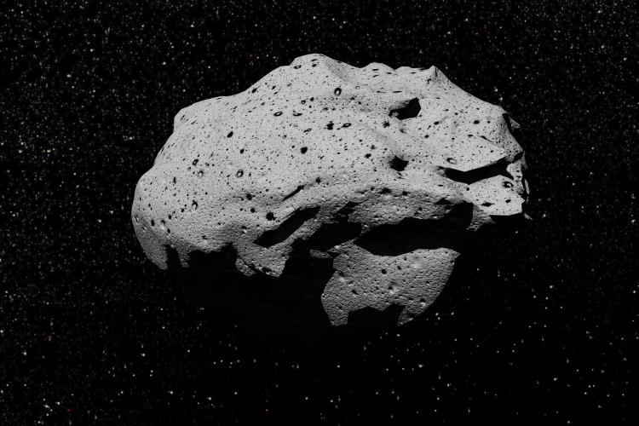
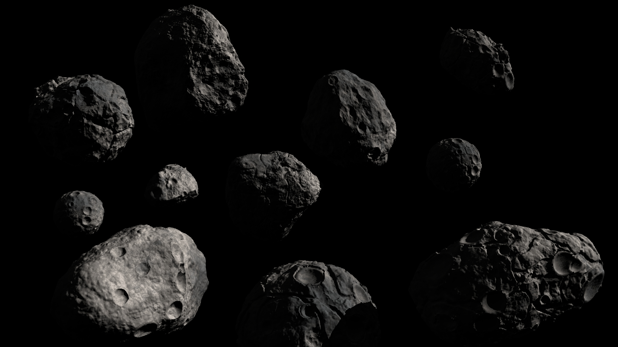
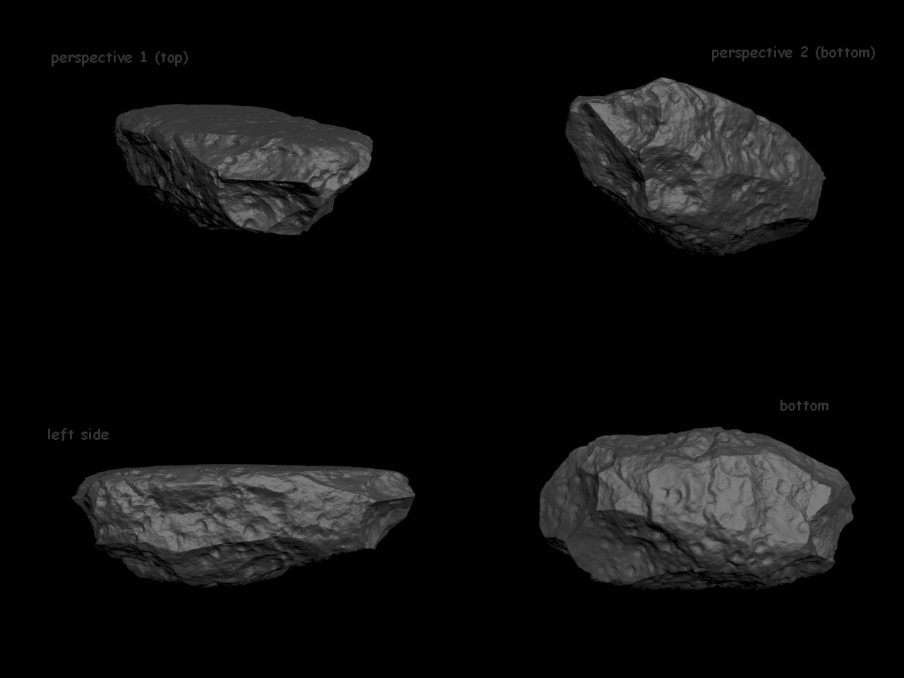
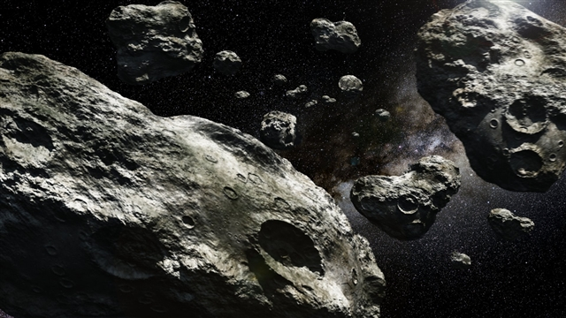
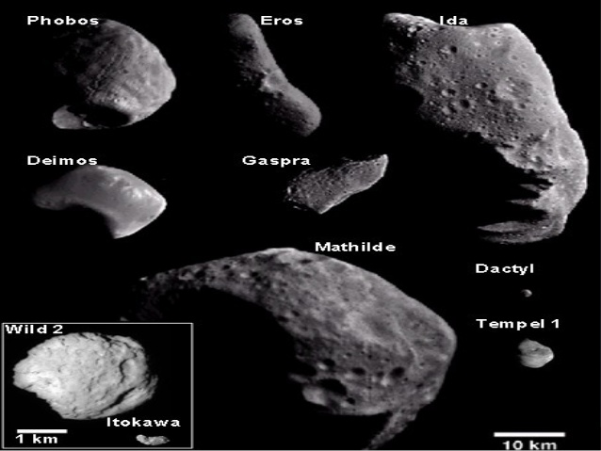
Notes:
Mood board showing normal asteroids, we can see from these that there are some characteristic that stand out, such as the random sized craters and the random shape of the asteroids also a lot of shadow/shading

Slide 4
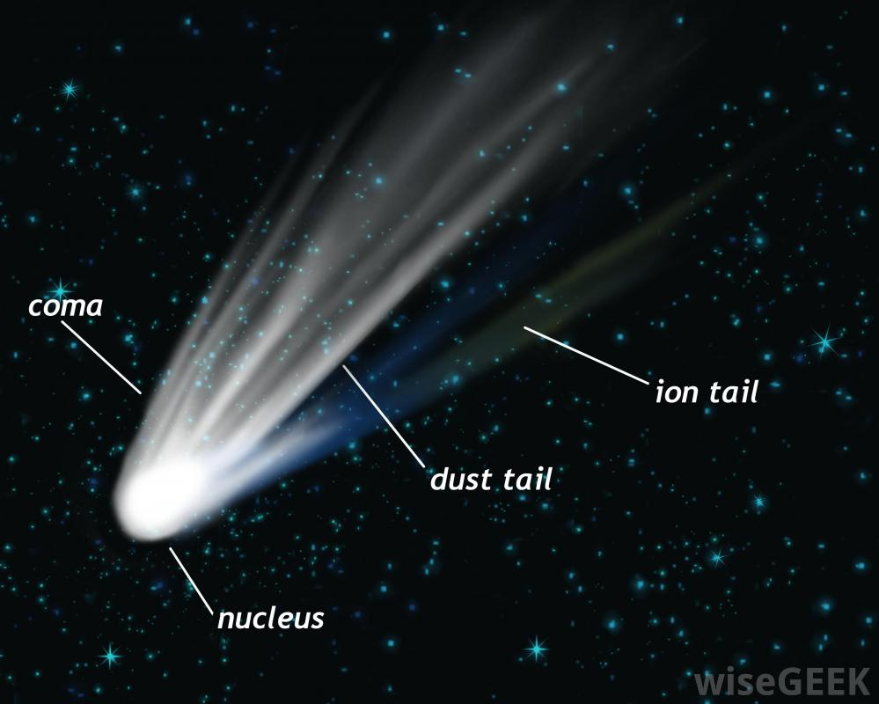
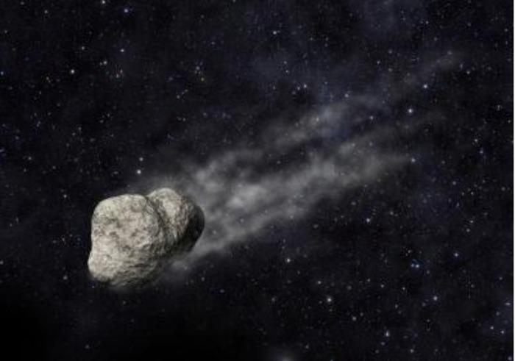
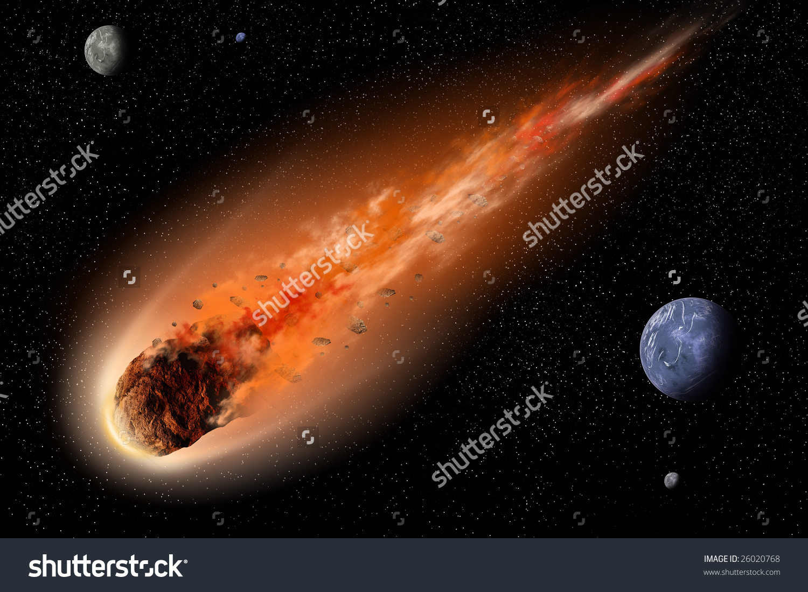
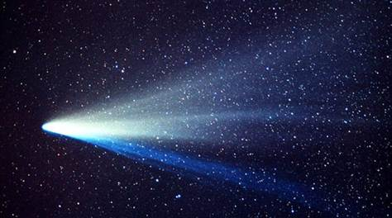
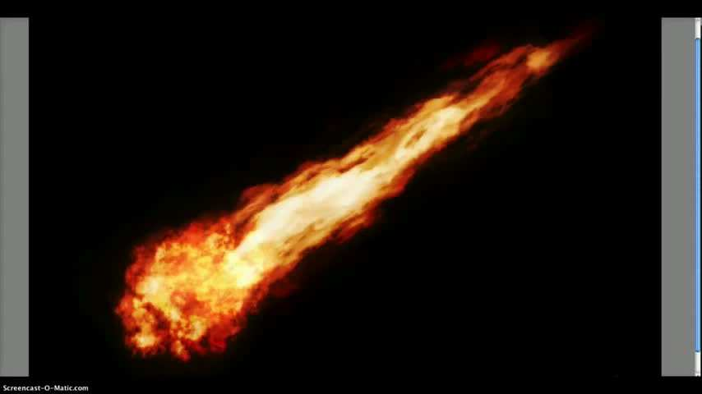
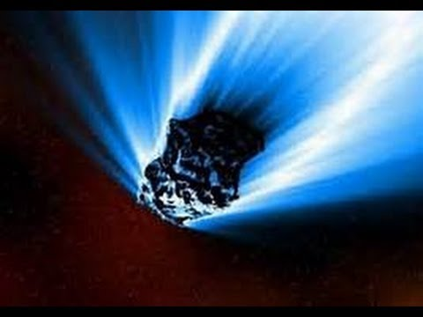
Notes:
This mood board shows asteroids with tails either from the asteroid breaking down or getting close to a atmosphere, these dust clouds and/or fire will be a great visual mechanic we could potentially add into our game after the core aspect is achieved

Slide 5
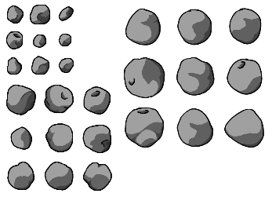
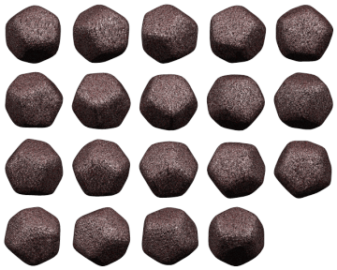
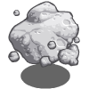
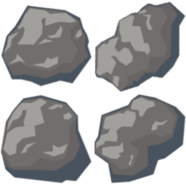
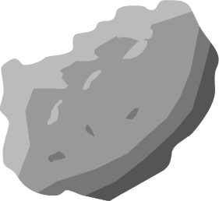
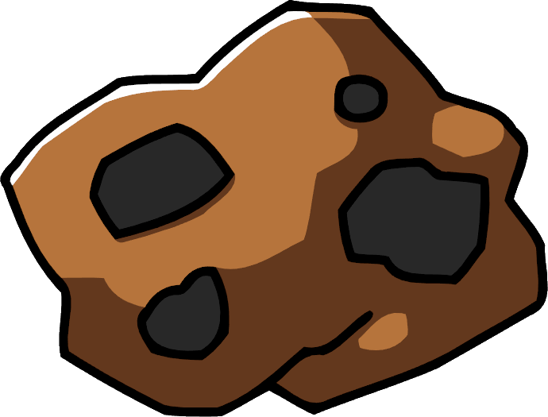
Notes:
This mood board is different as these asteroids are sprites that would work well in game, we can see that compared to the others the characteristics are similar from the random shapes and craters as well as the shadows/shading, this will be something we consider when creating our own asteroids.

Slide 6
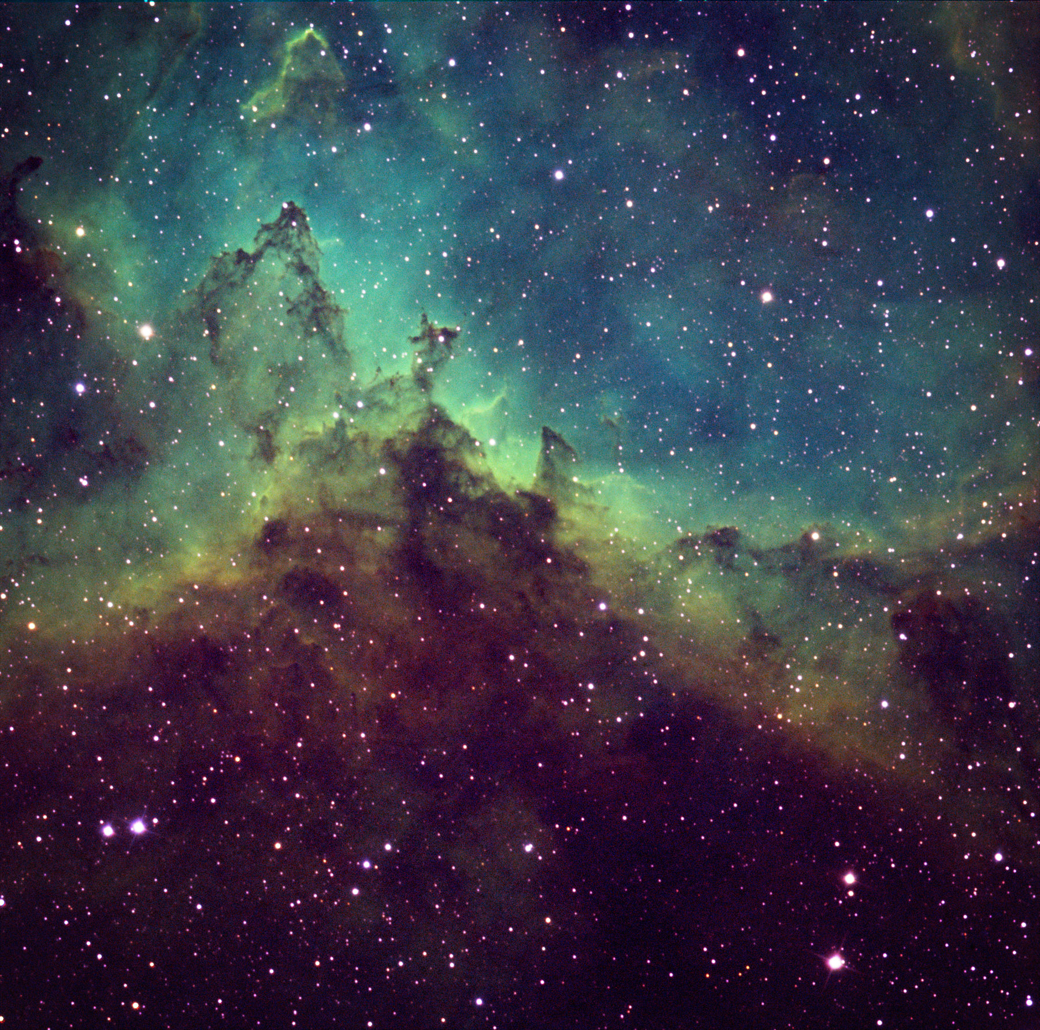
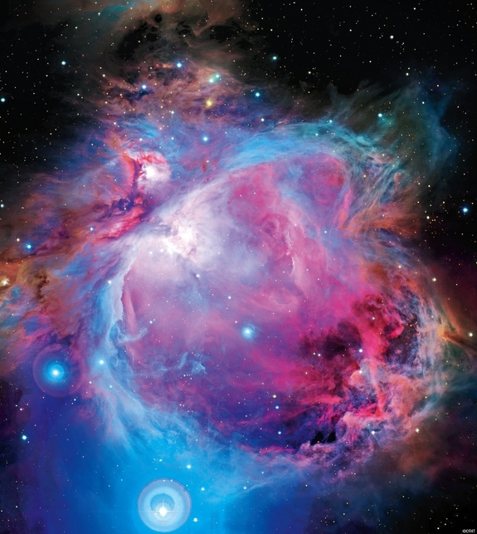
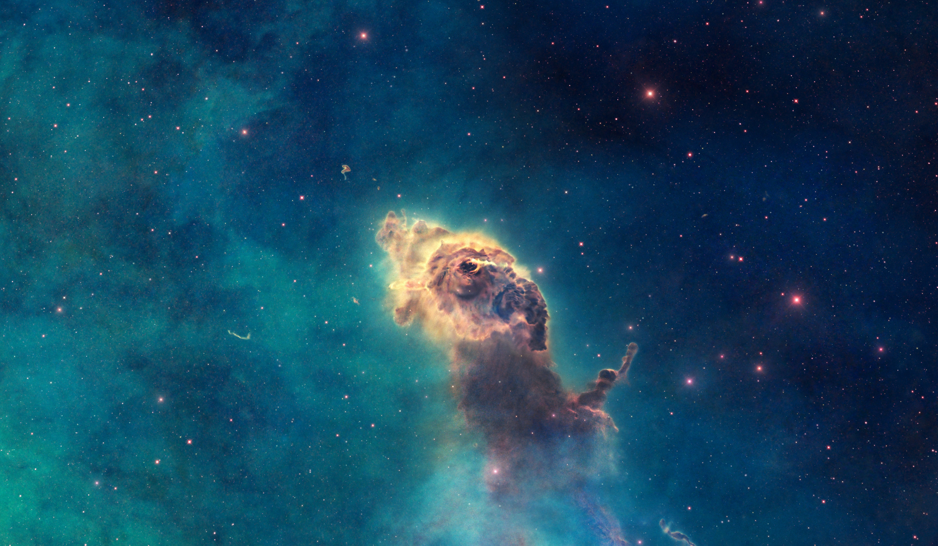
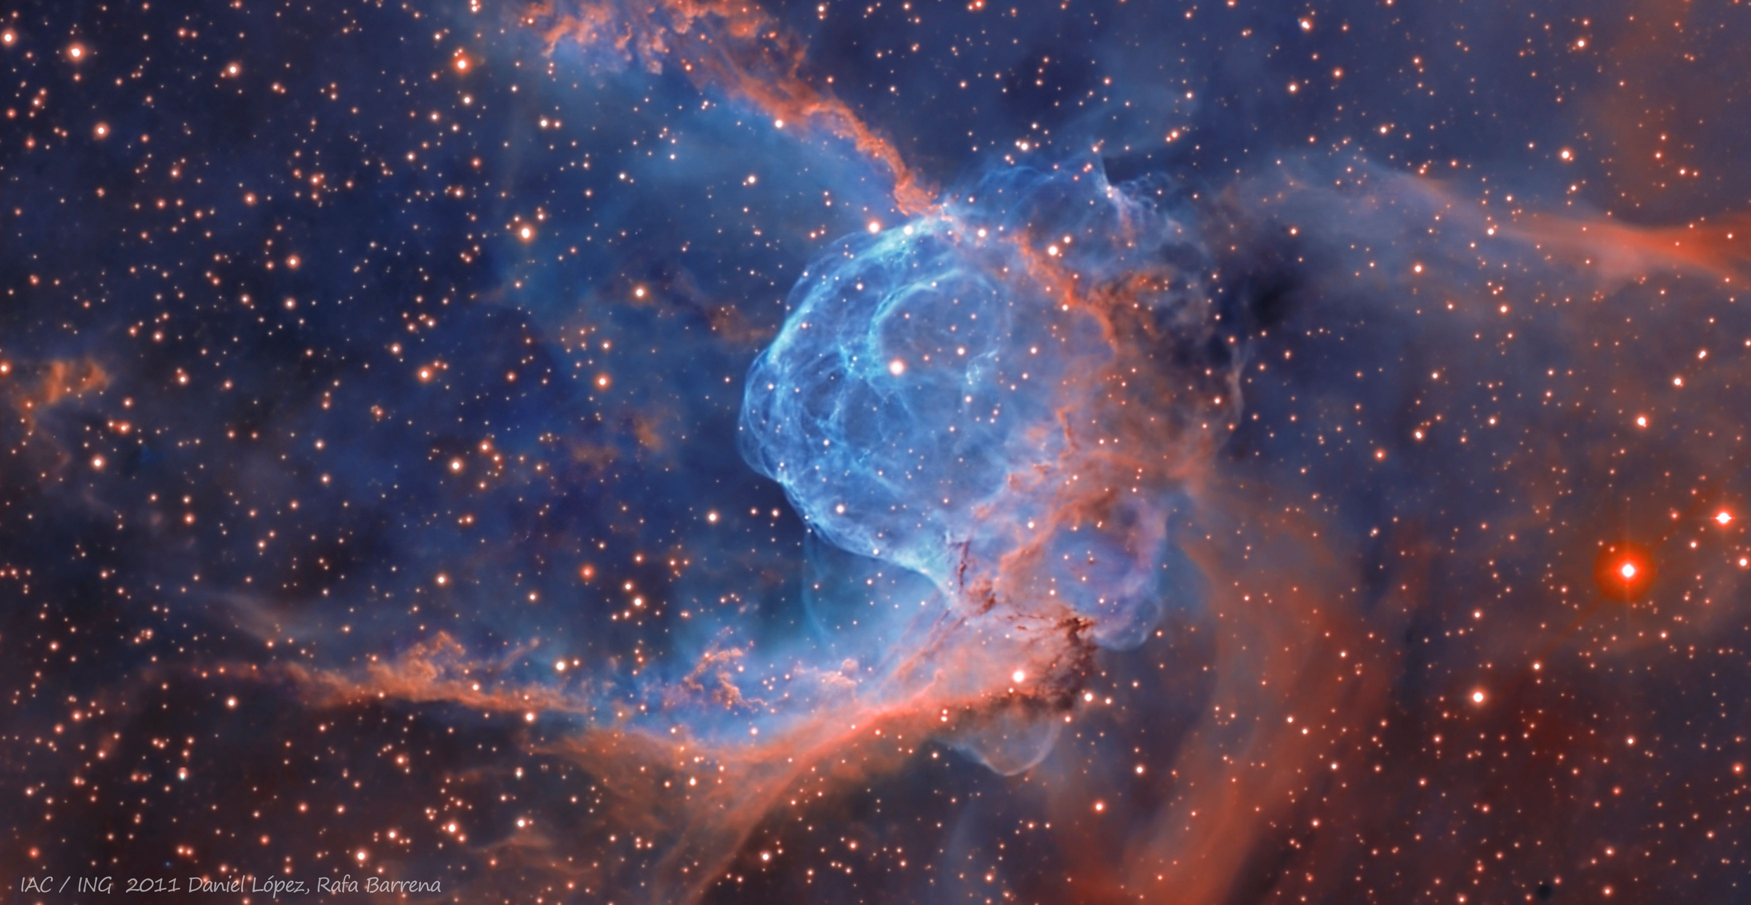
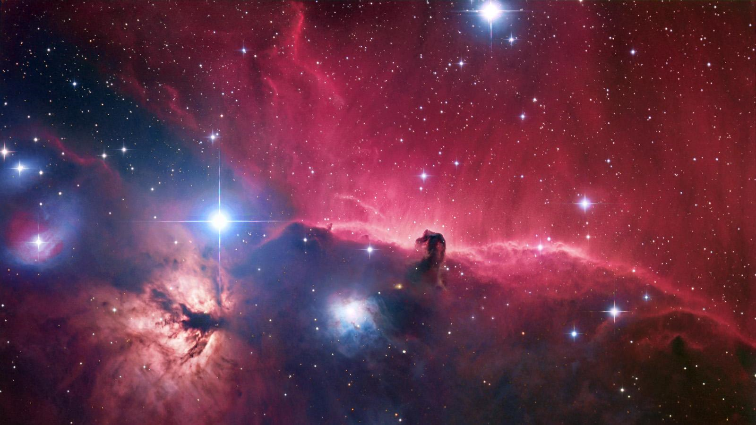
Notes:
Mood board includes images of a nebula, these images are filled with different colours the complement each other and also include bright stars dotted around which also vary in colour. There is also a lot of misty/cloud on all of the images, we will consider this when creating our background

Slide 7
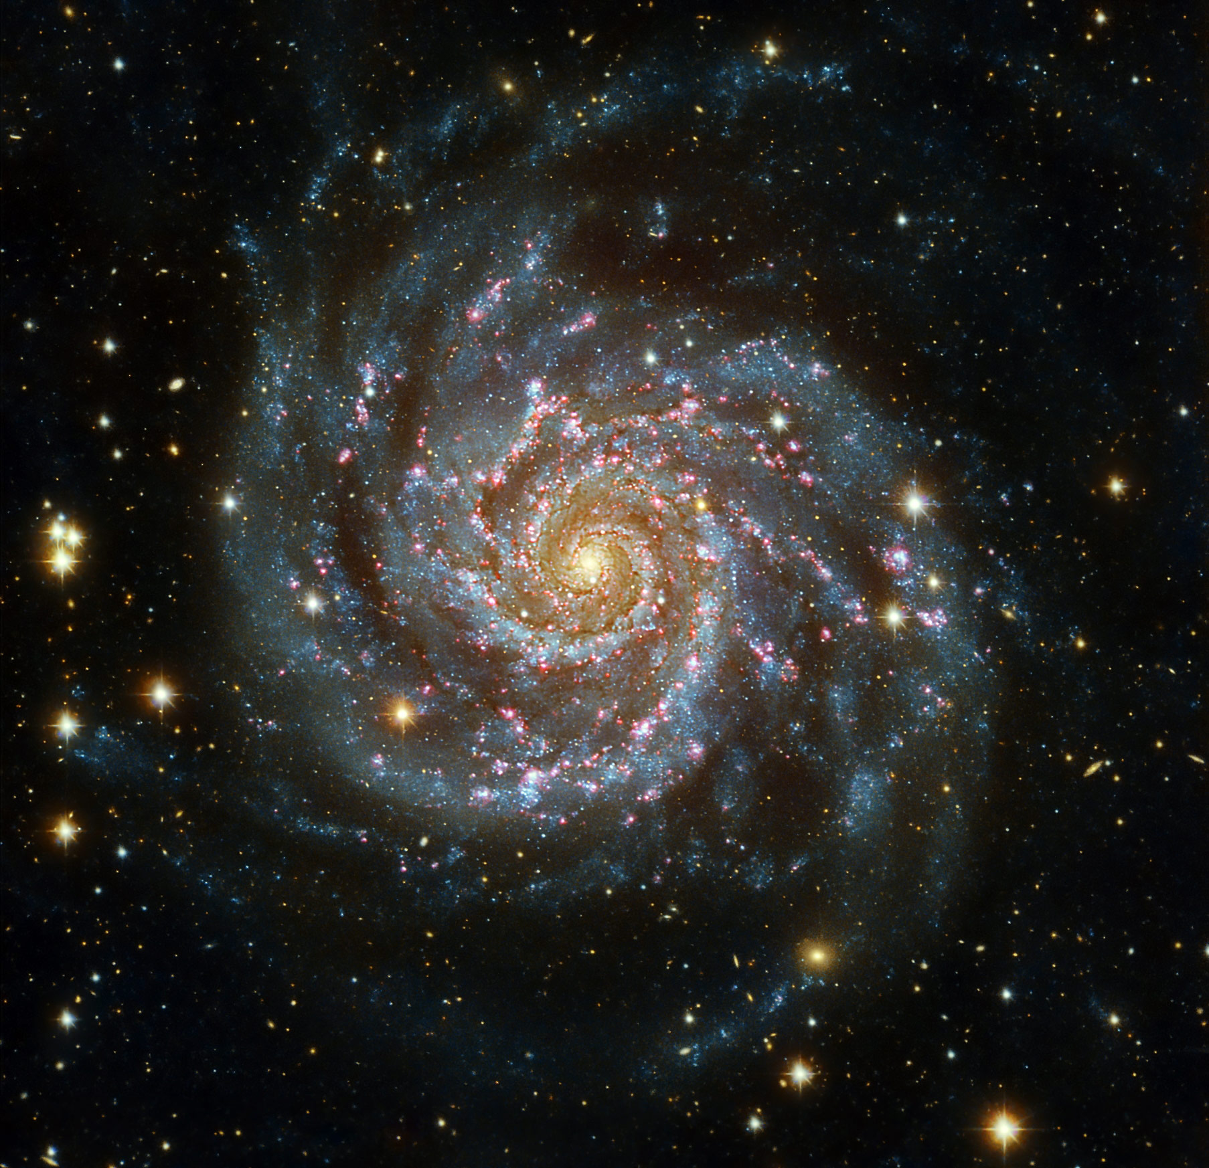
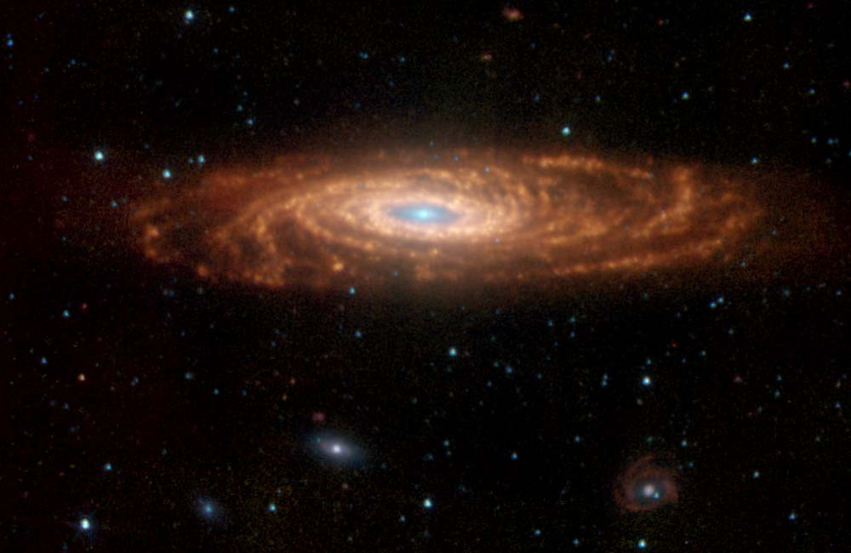
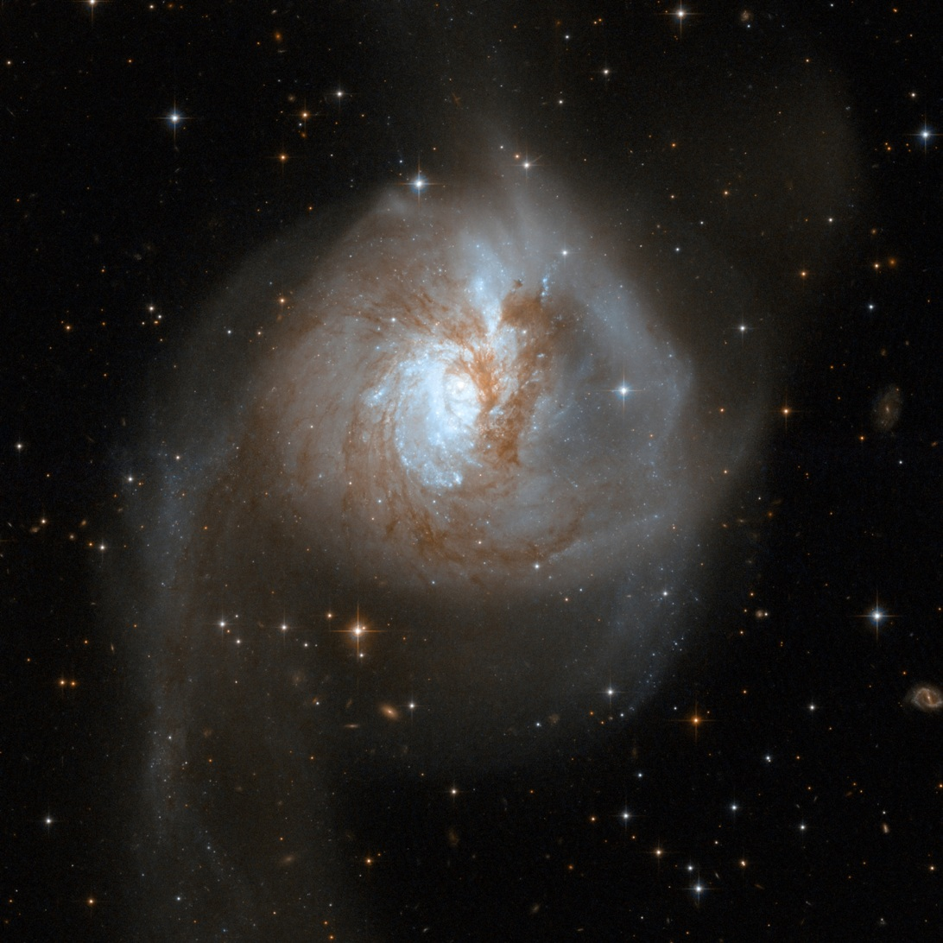
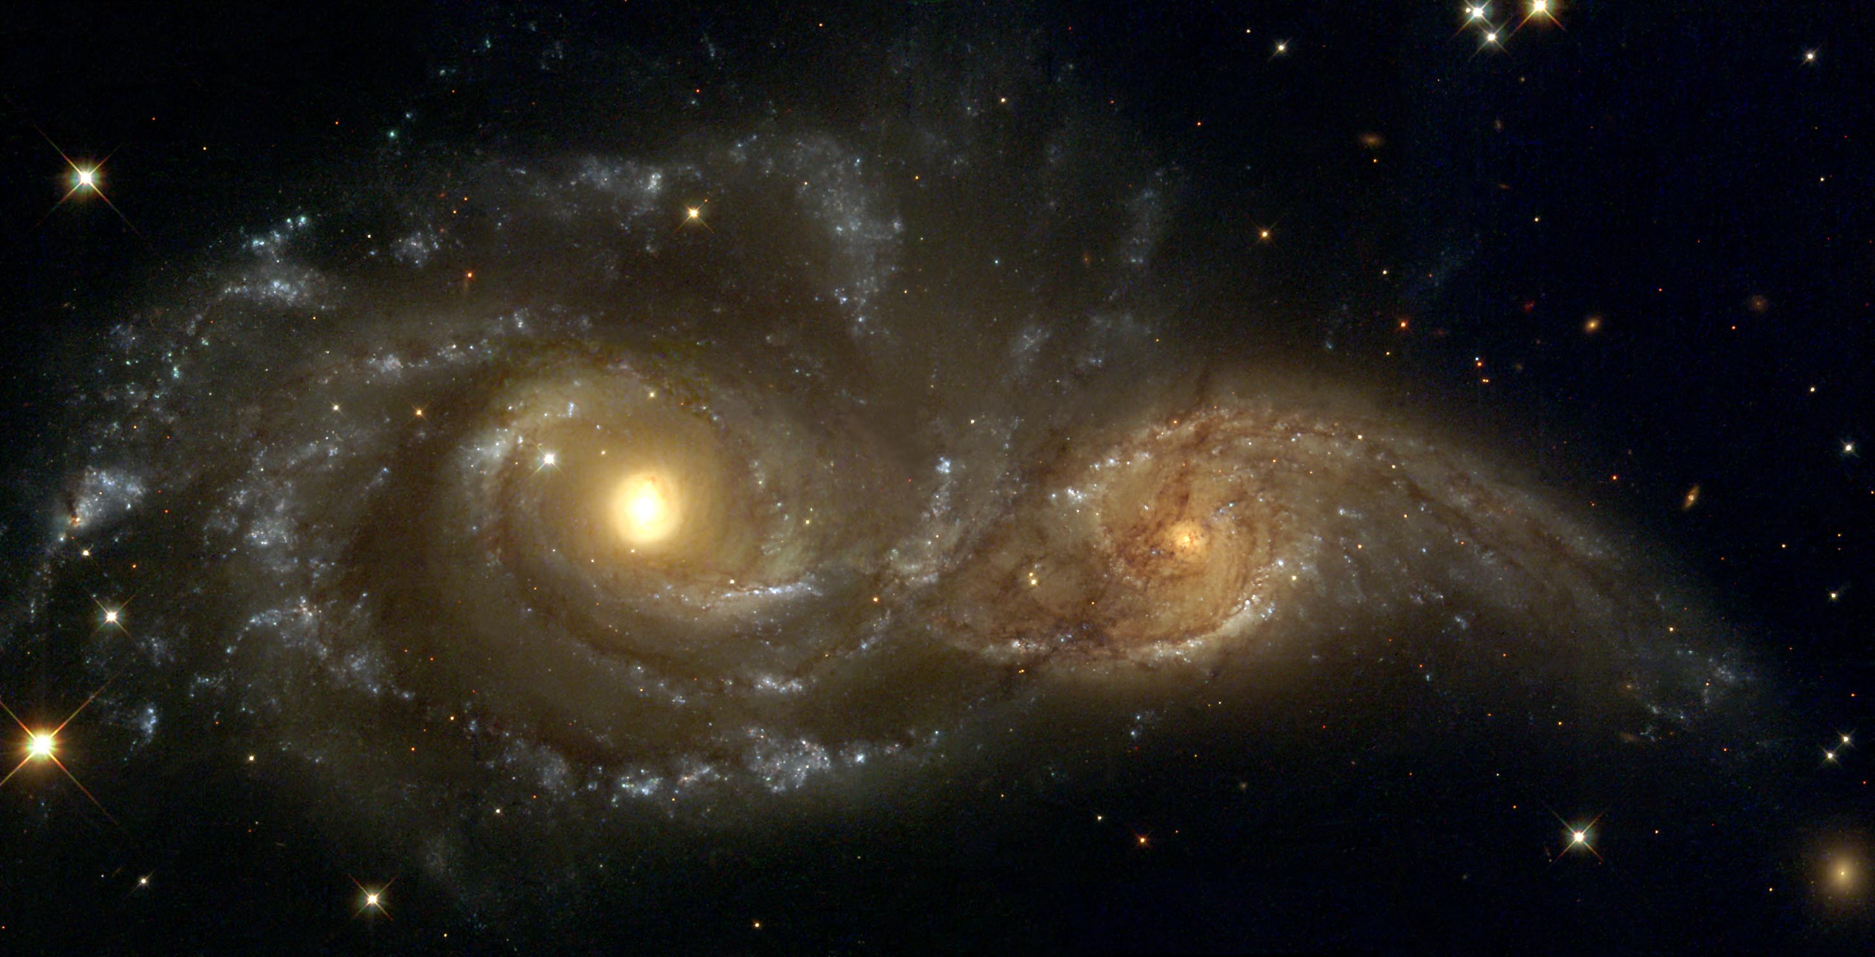
Notes:
I have also looked at different galaxies we could use, this mood board shows us that the images share a circle shape, as well as a lot of different colours.

Slide 8
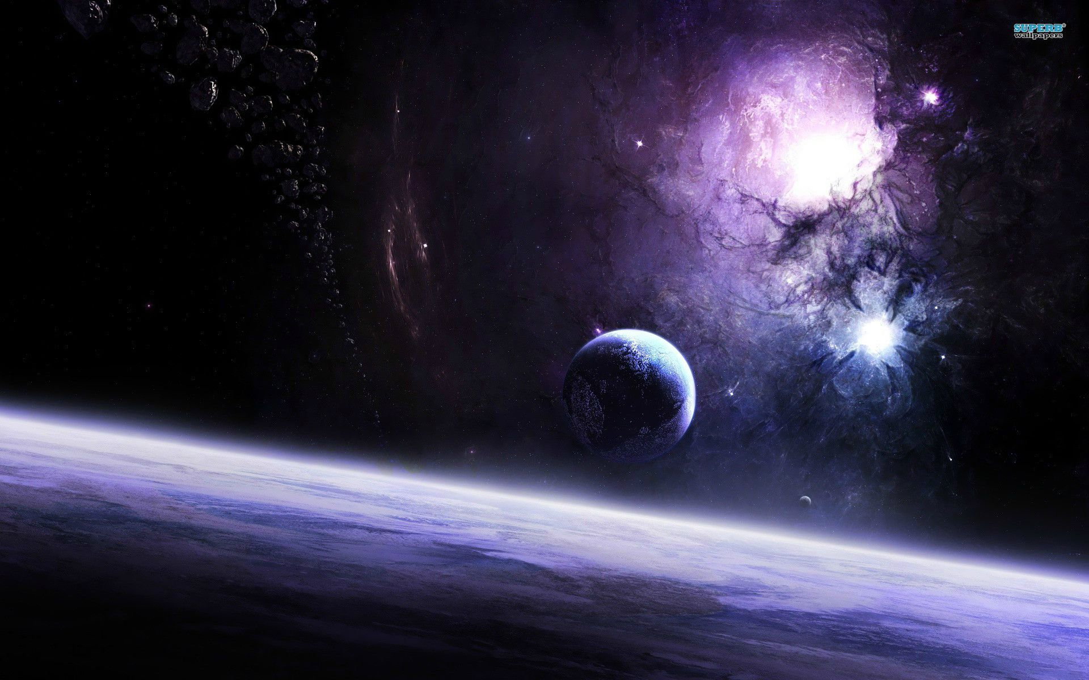
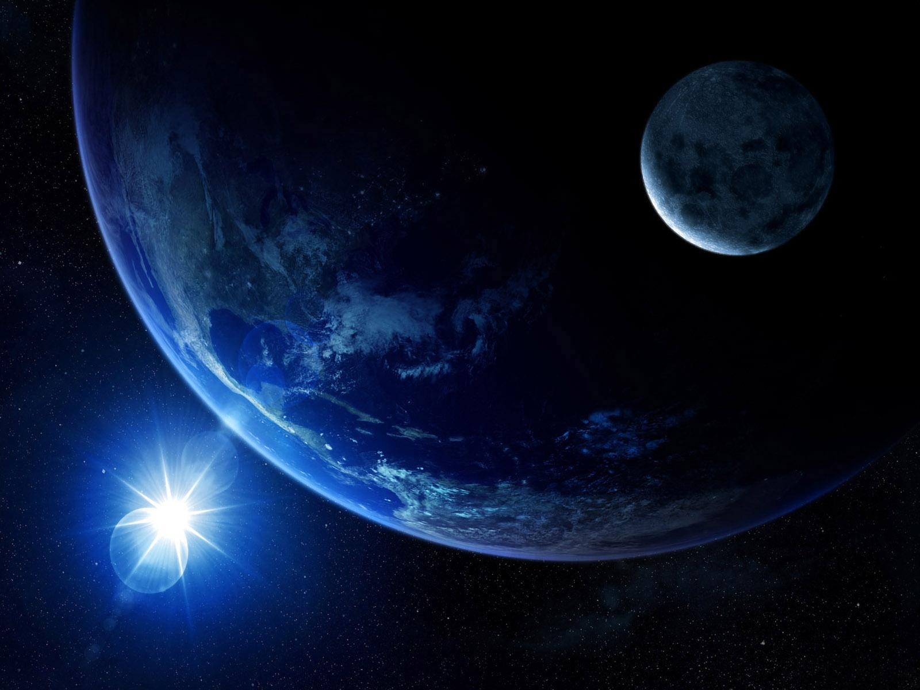
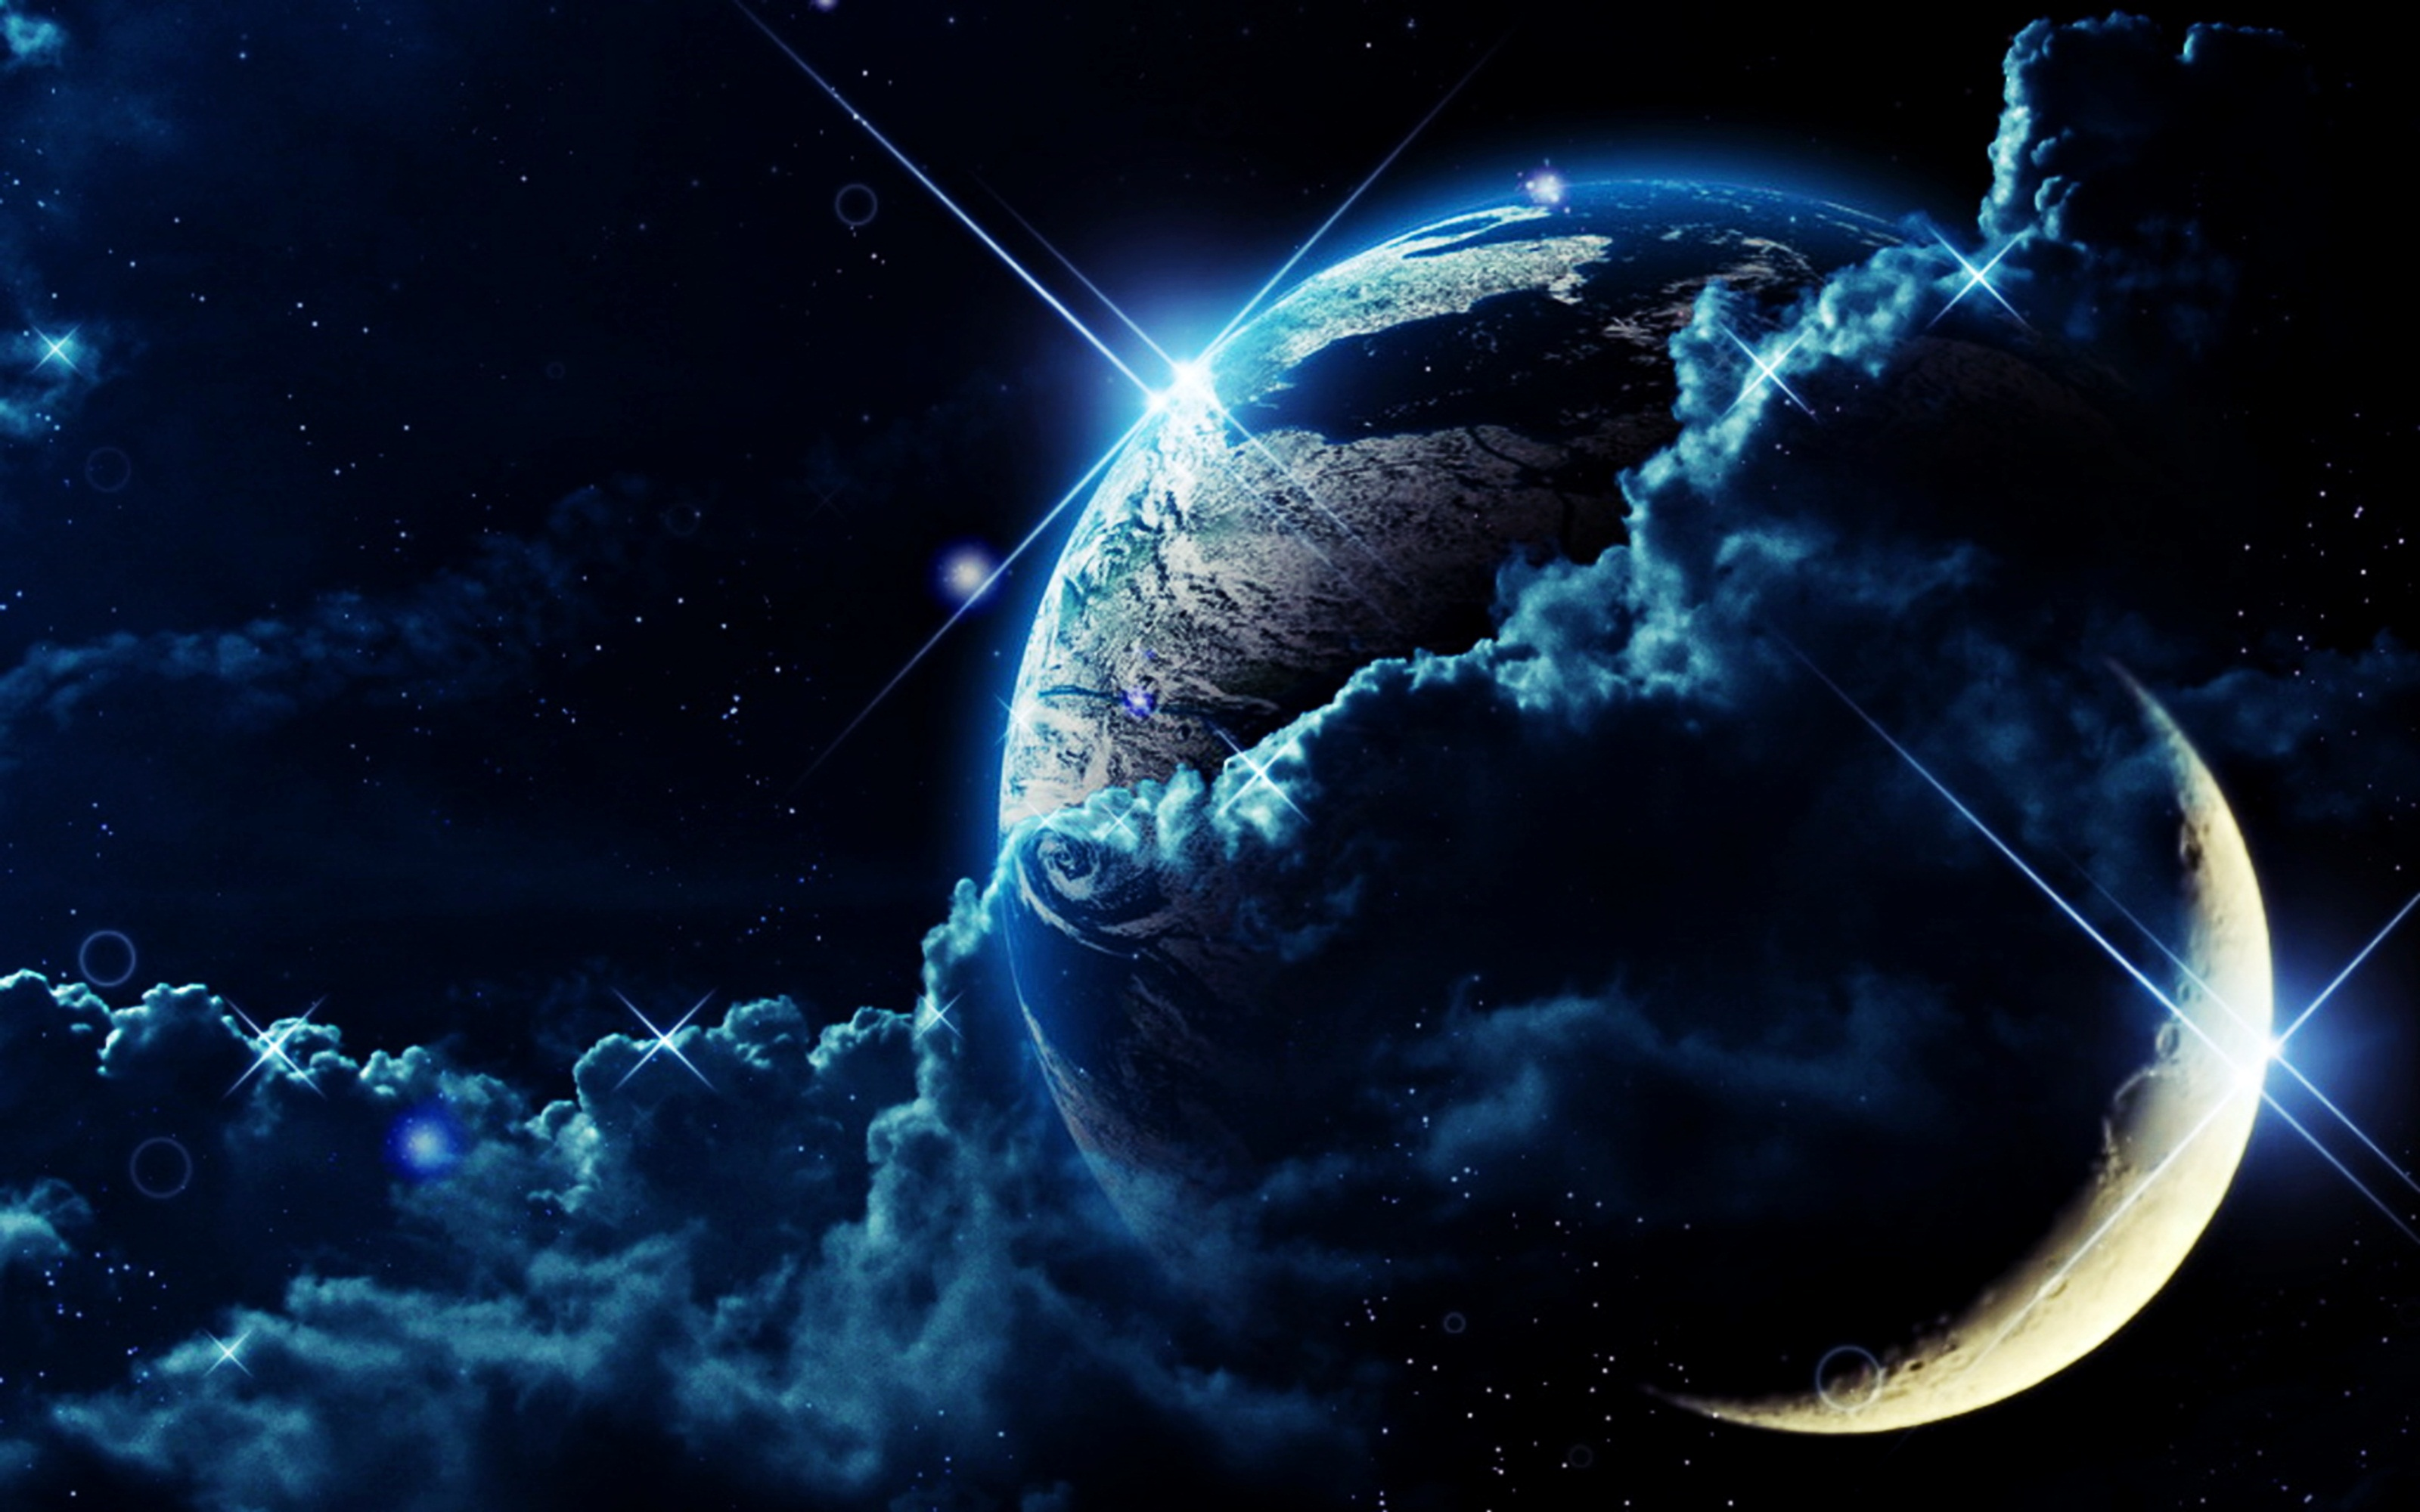
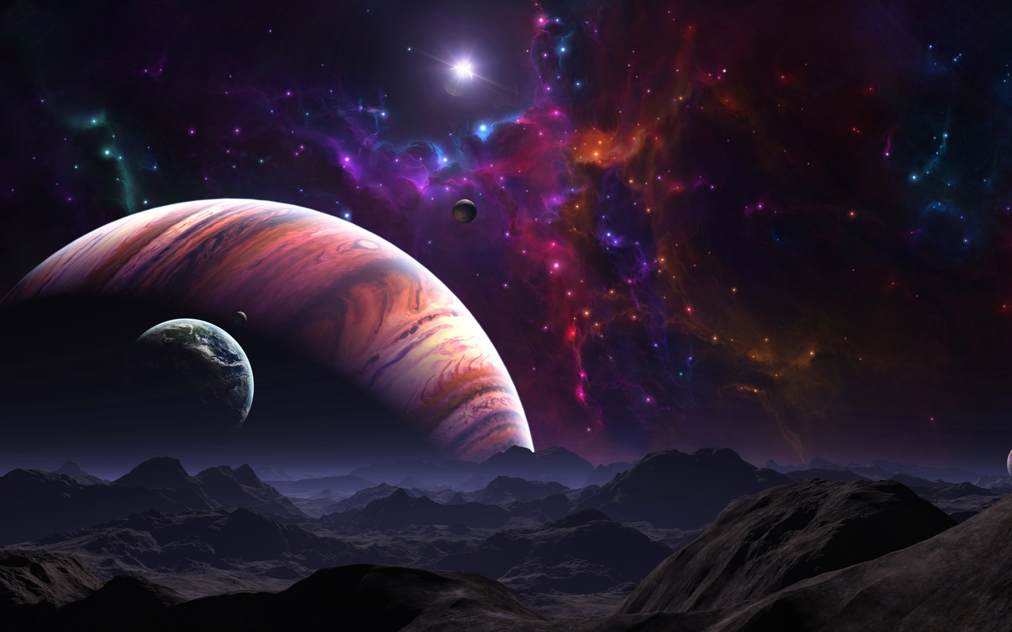
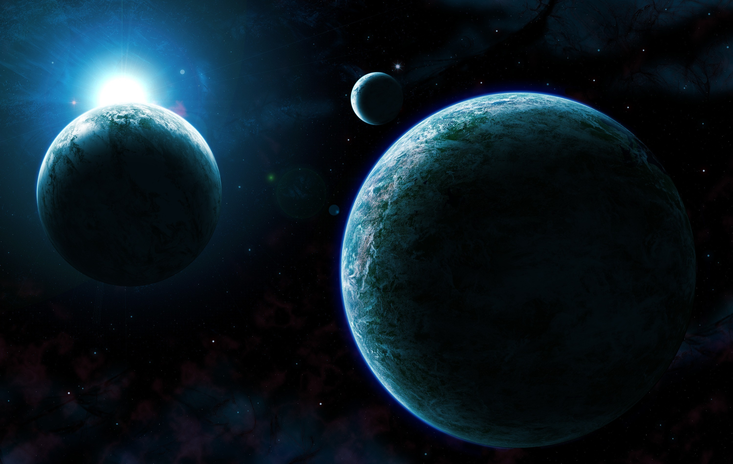
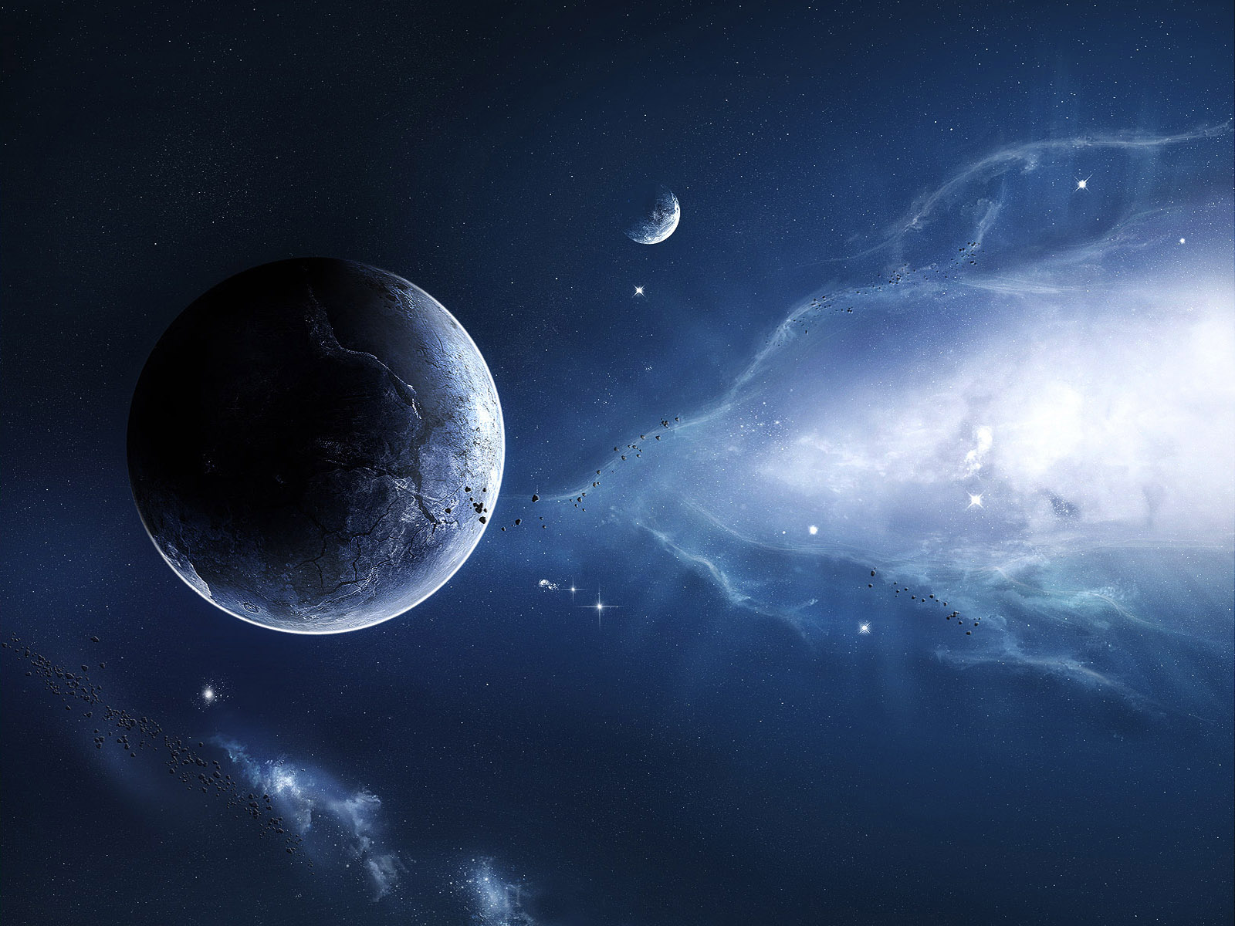
Notes:
Lastly, I looked at different planets for our background and this mood board shows my findings, the majority of the planets are dark and have a sun or light flare behind them, there is a lot of shading/shadow on the planets

